Slide 1
ICE BREAKING ACTIVITY
BE A JOURNALIST!!!!

Slide 2
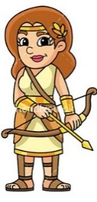
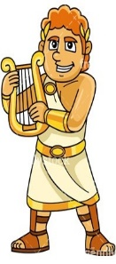
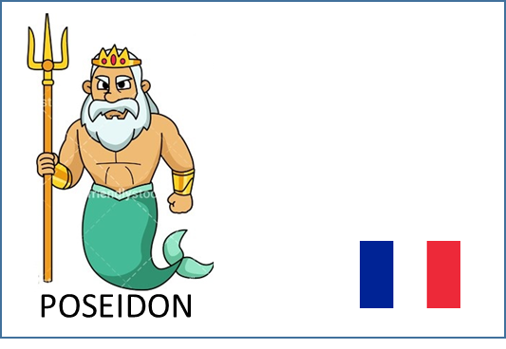
INSTRUCTIONS
THE STUDENTS FORMED 8 TEAMS WITH ALL NATIONALITIES IN EACH TEAM
EVERY TEAM HAD A NAME OF AN ANCIENT GREEK GOD
EACH TEAM RECEIVED AN ENVELOP WITH 5 PICTURES, 50 WORDS AND UTILITIES
ARTEMIS
APOLLON

Slide 3
THE PICTURES WERE
A GOLFER
MONEY
A COW
A PISTOL
A SCREAMING PERSON

Slide 4
1ST TASK TO WRITE 3 HEADLINES FOR THEIR NEWSPAPER WITH THE GIVEN WORDS
2ND TASK TO MAKE A VIDEO OF TV NEWS WITH THE SAME HEADLINES

Slide 5
THE NEWS PAPERS!!!!

Slide 7
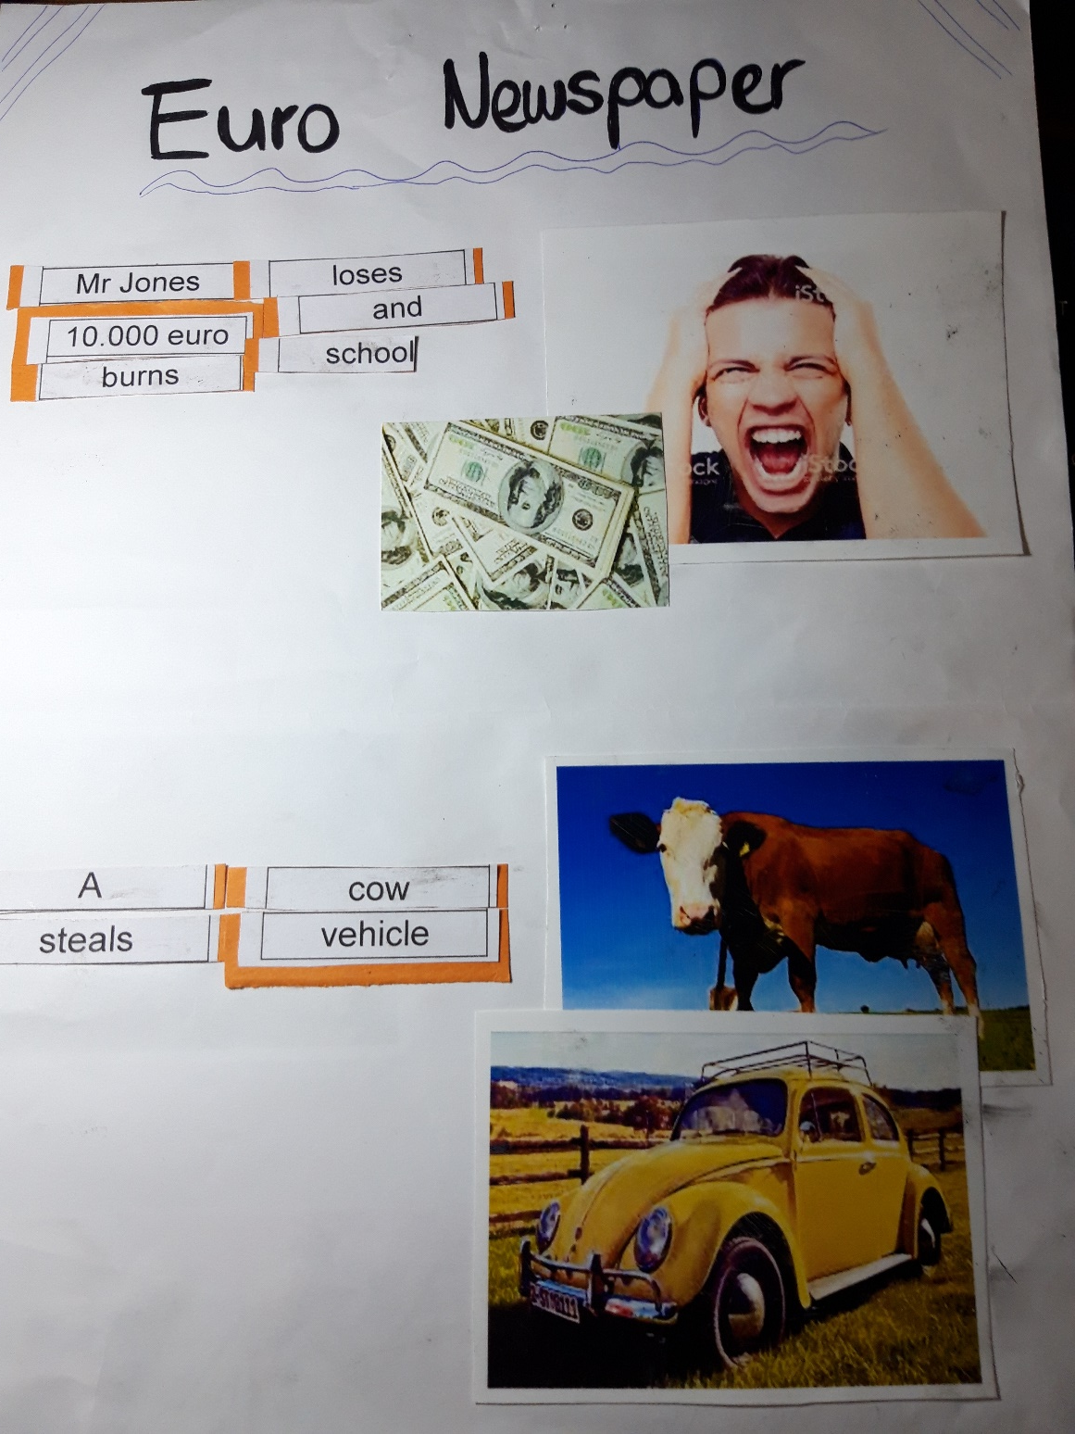

Slide 8
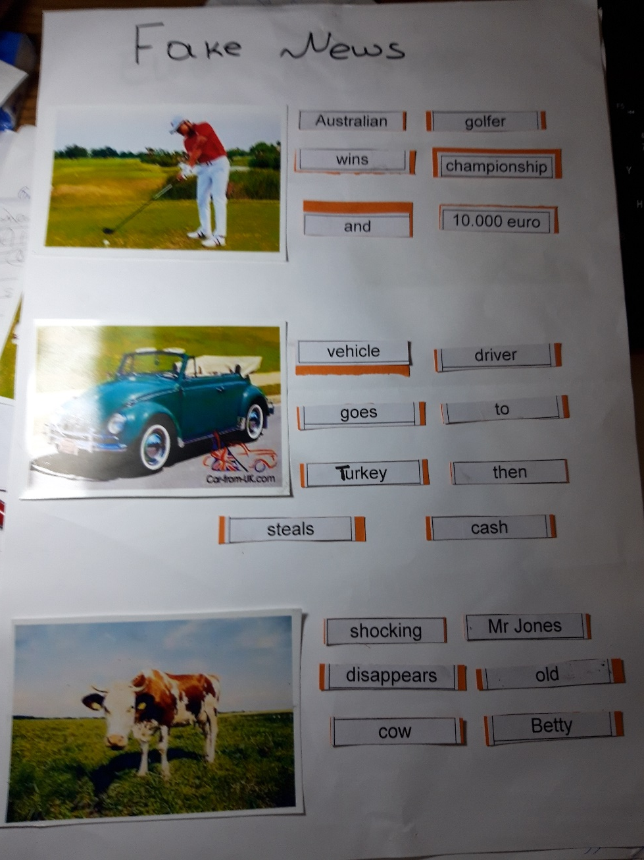

Slide 10
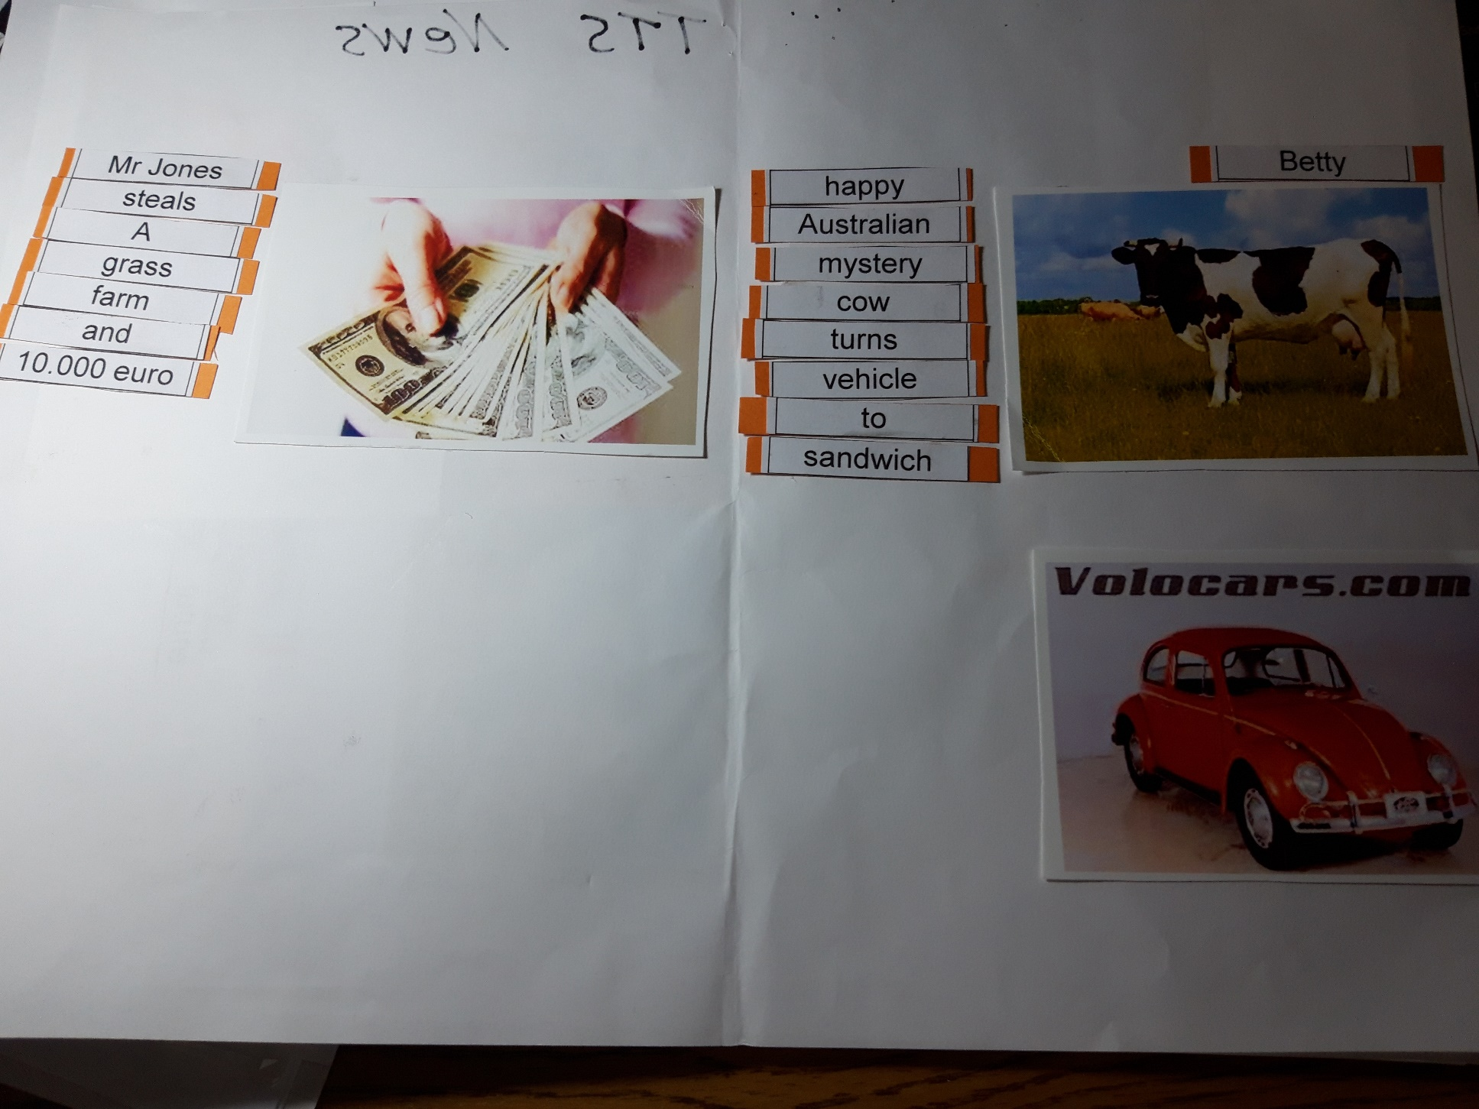

Slide 13
TV NEWS VIDEO

Slide 14
TV NEWS VIDEO

Slide 15
TV NEWS VIDEO

Slide 16
TV NEWS VIDEO

